Slide 1
Ping Pong Machine
Sahil Sahil

Slide 2
Introduction
Objective: Everyday cost-effective ping pong machine.
Problem: Use the solenoid to let pass the ball at right time. and how to control the power
Explanation: Solenoid is electromagnet, which act as pull and push when applied voltage. So use it as stop balls and let them pass after given interval of time.
Solution: Usually solenoid comes in 12V or more so I have to use a MOSFET power control kit to control it.

Slide 3
Budget
Raspberry Pi Model B CDN$ “102.50” + Shipping
USB to Ethernet Connector and Cable CDN$ “30”
MOSFET Power Control Kit(2 Times) CDN$ “40”

Slide 4
Schedule
Breadboard Design: while testing the circuit on breadboard I didn’t get much problems
PCB Design: I Have to change PCB design two times because I tried to use power control kit instead of resistor and diode on the circuit
Enclosure: designing the right size case was little tricky because, it was hard to cut at just right place on ports.

Slide 5
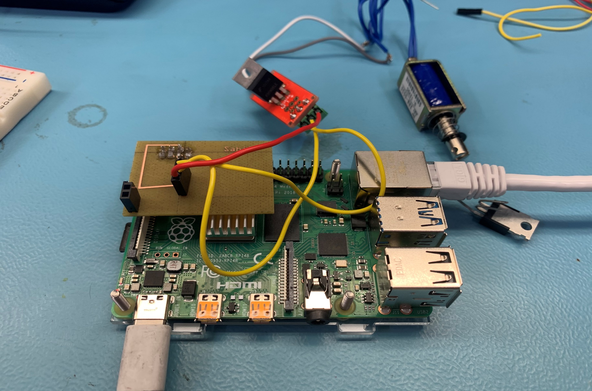
Illustration

Slide 6
Previous Course
CENG252 Embedded Systems this course taught me how to do programming on Raspberry Pi
https://www.flickr.com/photos/shaikh_sharique/14545603370/
Google.

